Slide 1

Tablet launch: Customer Survey Responses

Slide 2
Summary
The goal was to increase the overall experience of using the tablet to order food and thus achieve a good customer satisfaction.
The staffs were trained to instruct customer on how to navigate through the tablet and place an order which resulted in a good customer review.
Achieved an overall table turn around time of 30 minutes.

Slide 3
Overview
A survey was conducted on 50 customers during the pilot launch of the tablet and were asked to use the tablet to order food and try the checkout system.
The purpose of the survey was to see if the customers had a good dining experience with the tablets.
The survey results show an overall good customer satisfaction and few areas where the improvements are needed.

Slide 4
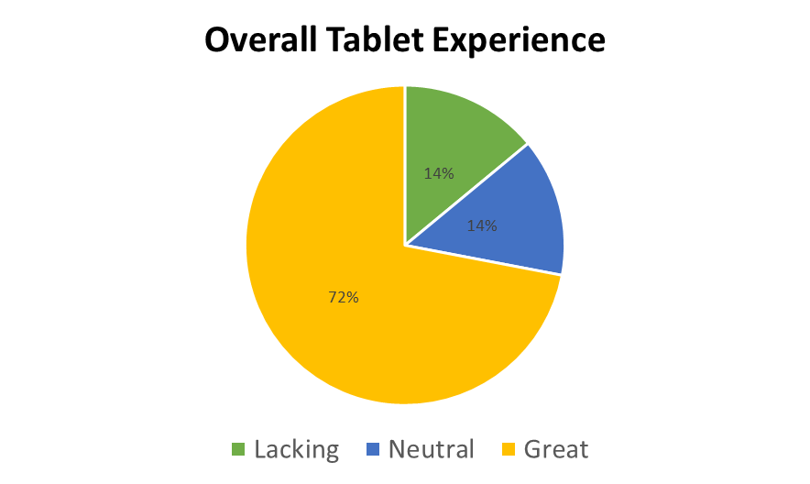
Findings

Slide 5
Next Steps
The order accuracy of only 72% was achieved over the set target of 98%.
The orders has to be pre checked for quality before it leaves the kitchen.
Train the kitchen staffs to ensure that they respond to the change in the order and the right food is served to the right table.

Slide 6
Next Steps
The tablet performance was an issue that was highlighted by the customer frequently.
The software team should ensure the tablets work properly without any technical glitches.
Train the staff on how to resolve few technical issues if the tablet gets frozen, so that they can help the customer.

